Slide 1
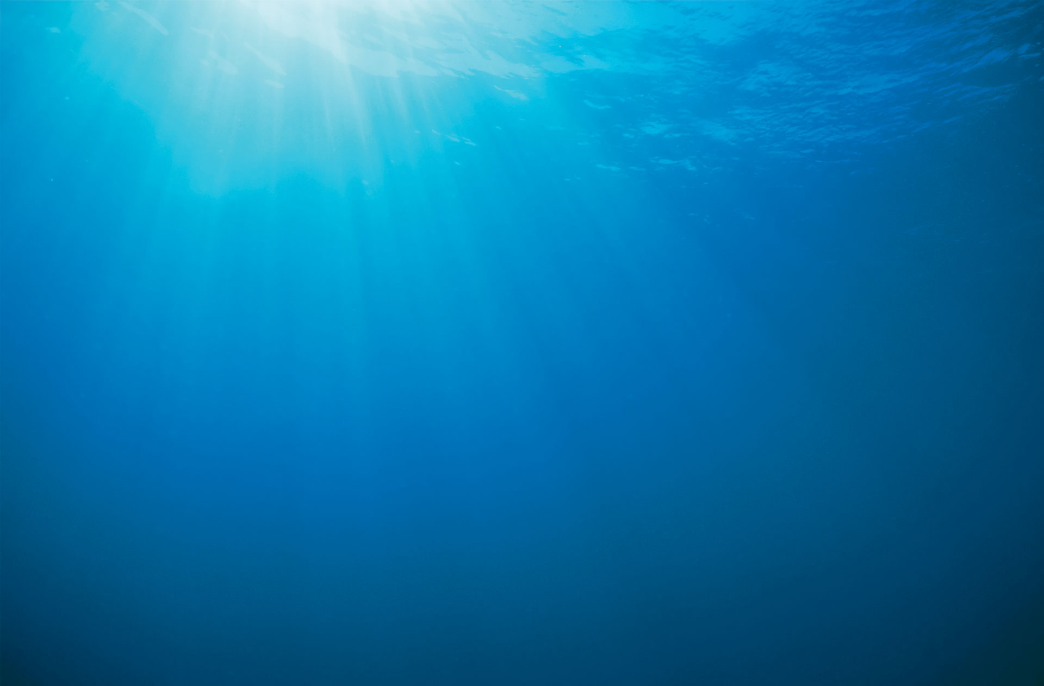
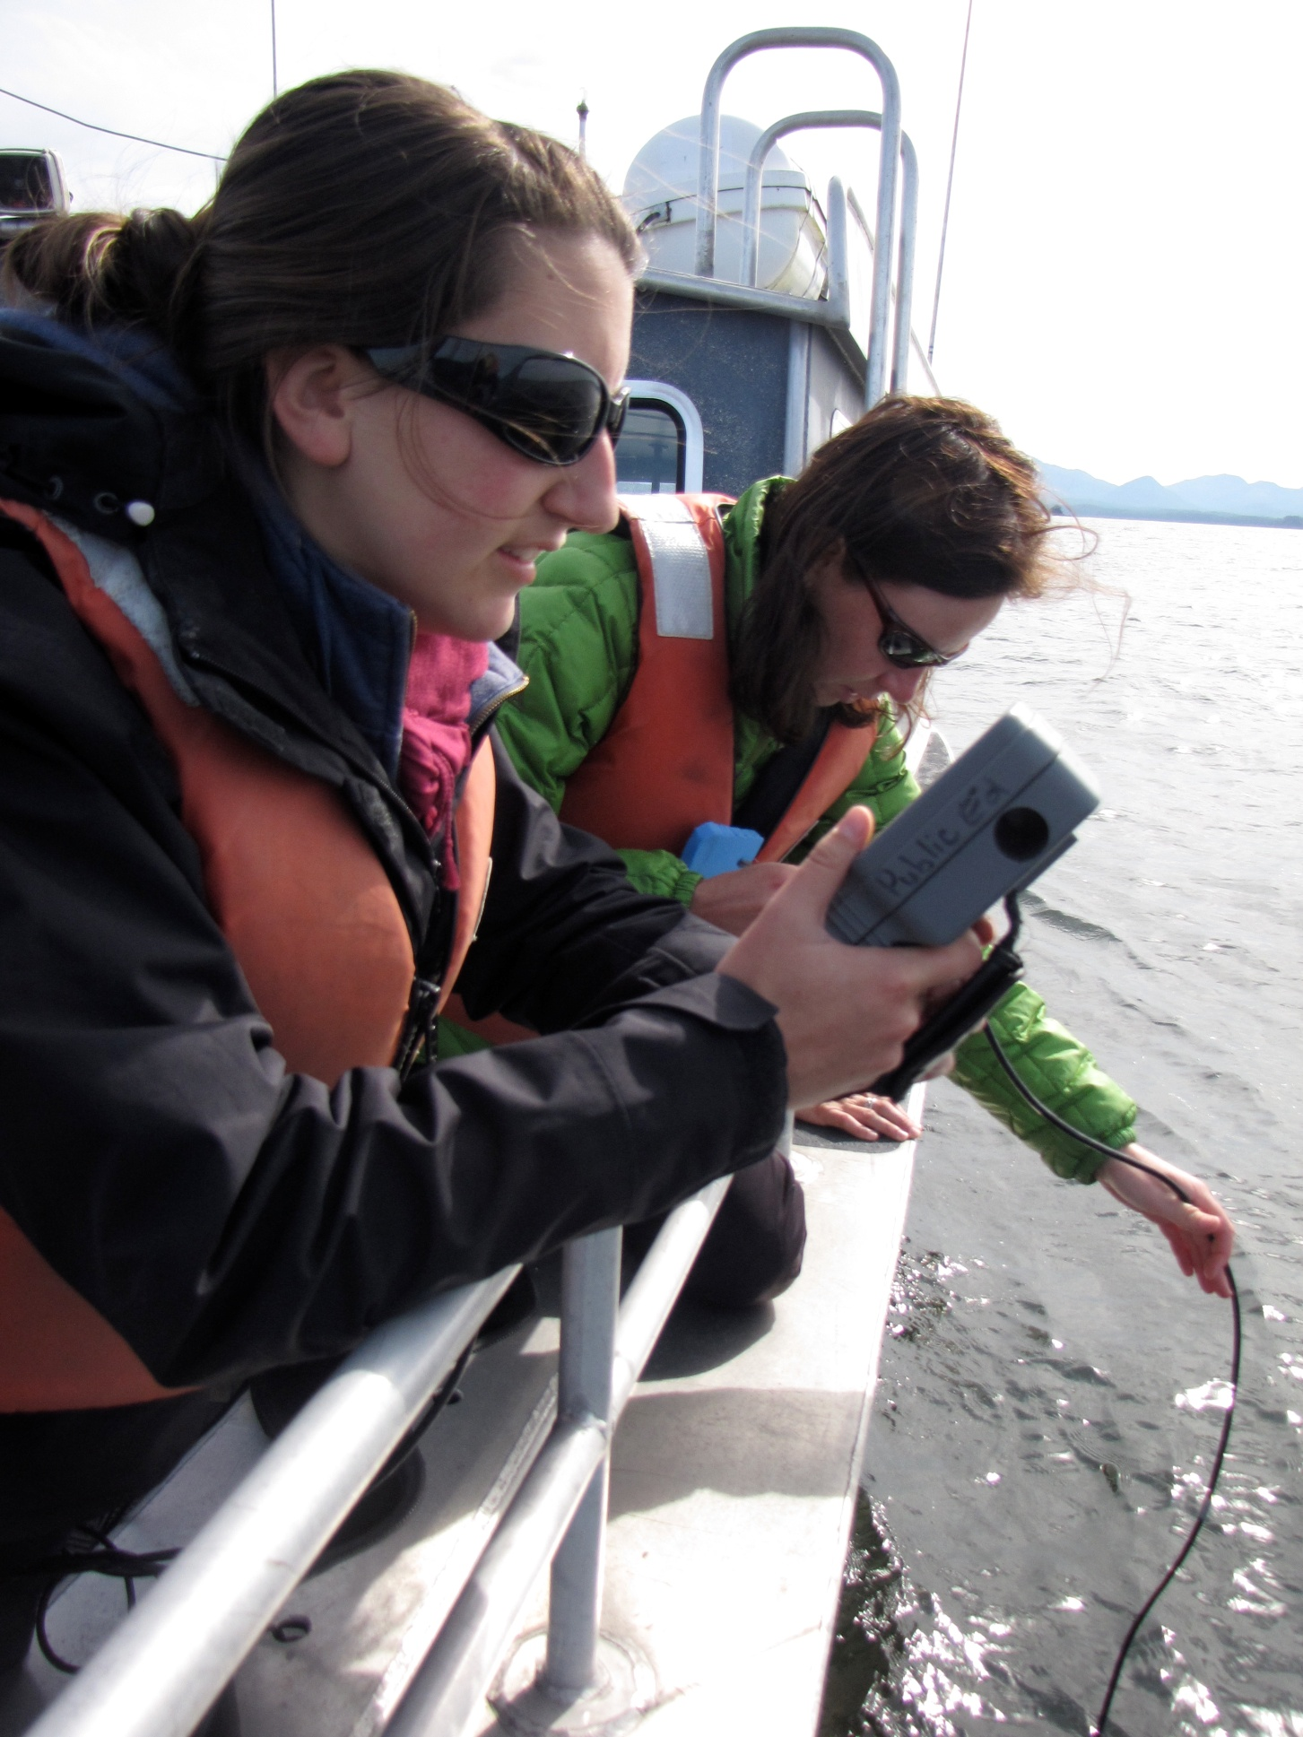
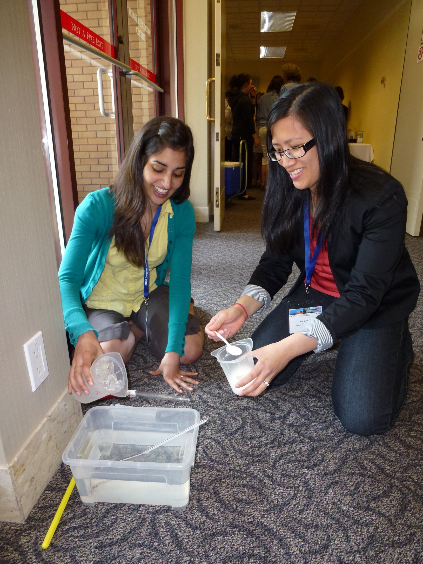
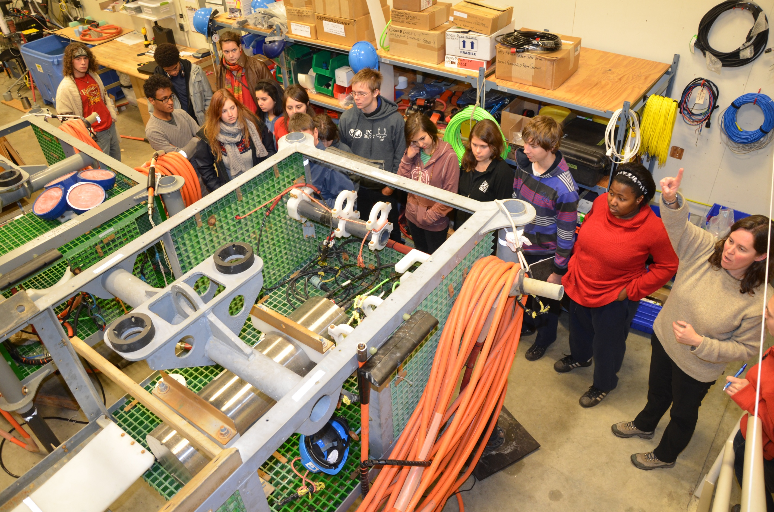
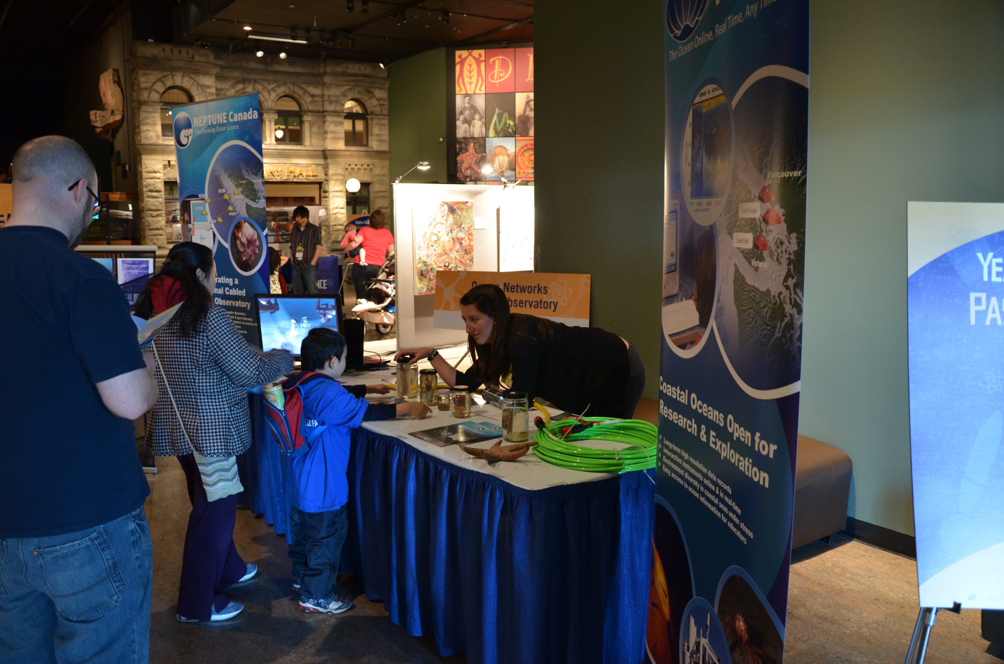
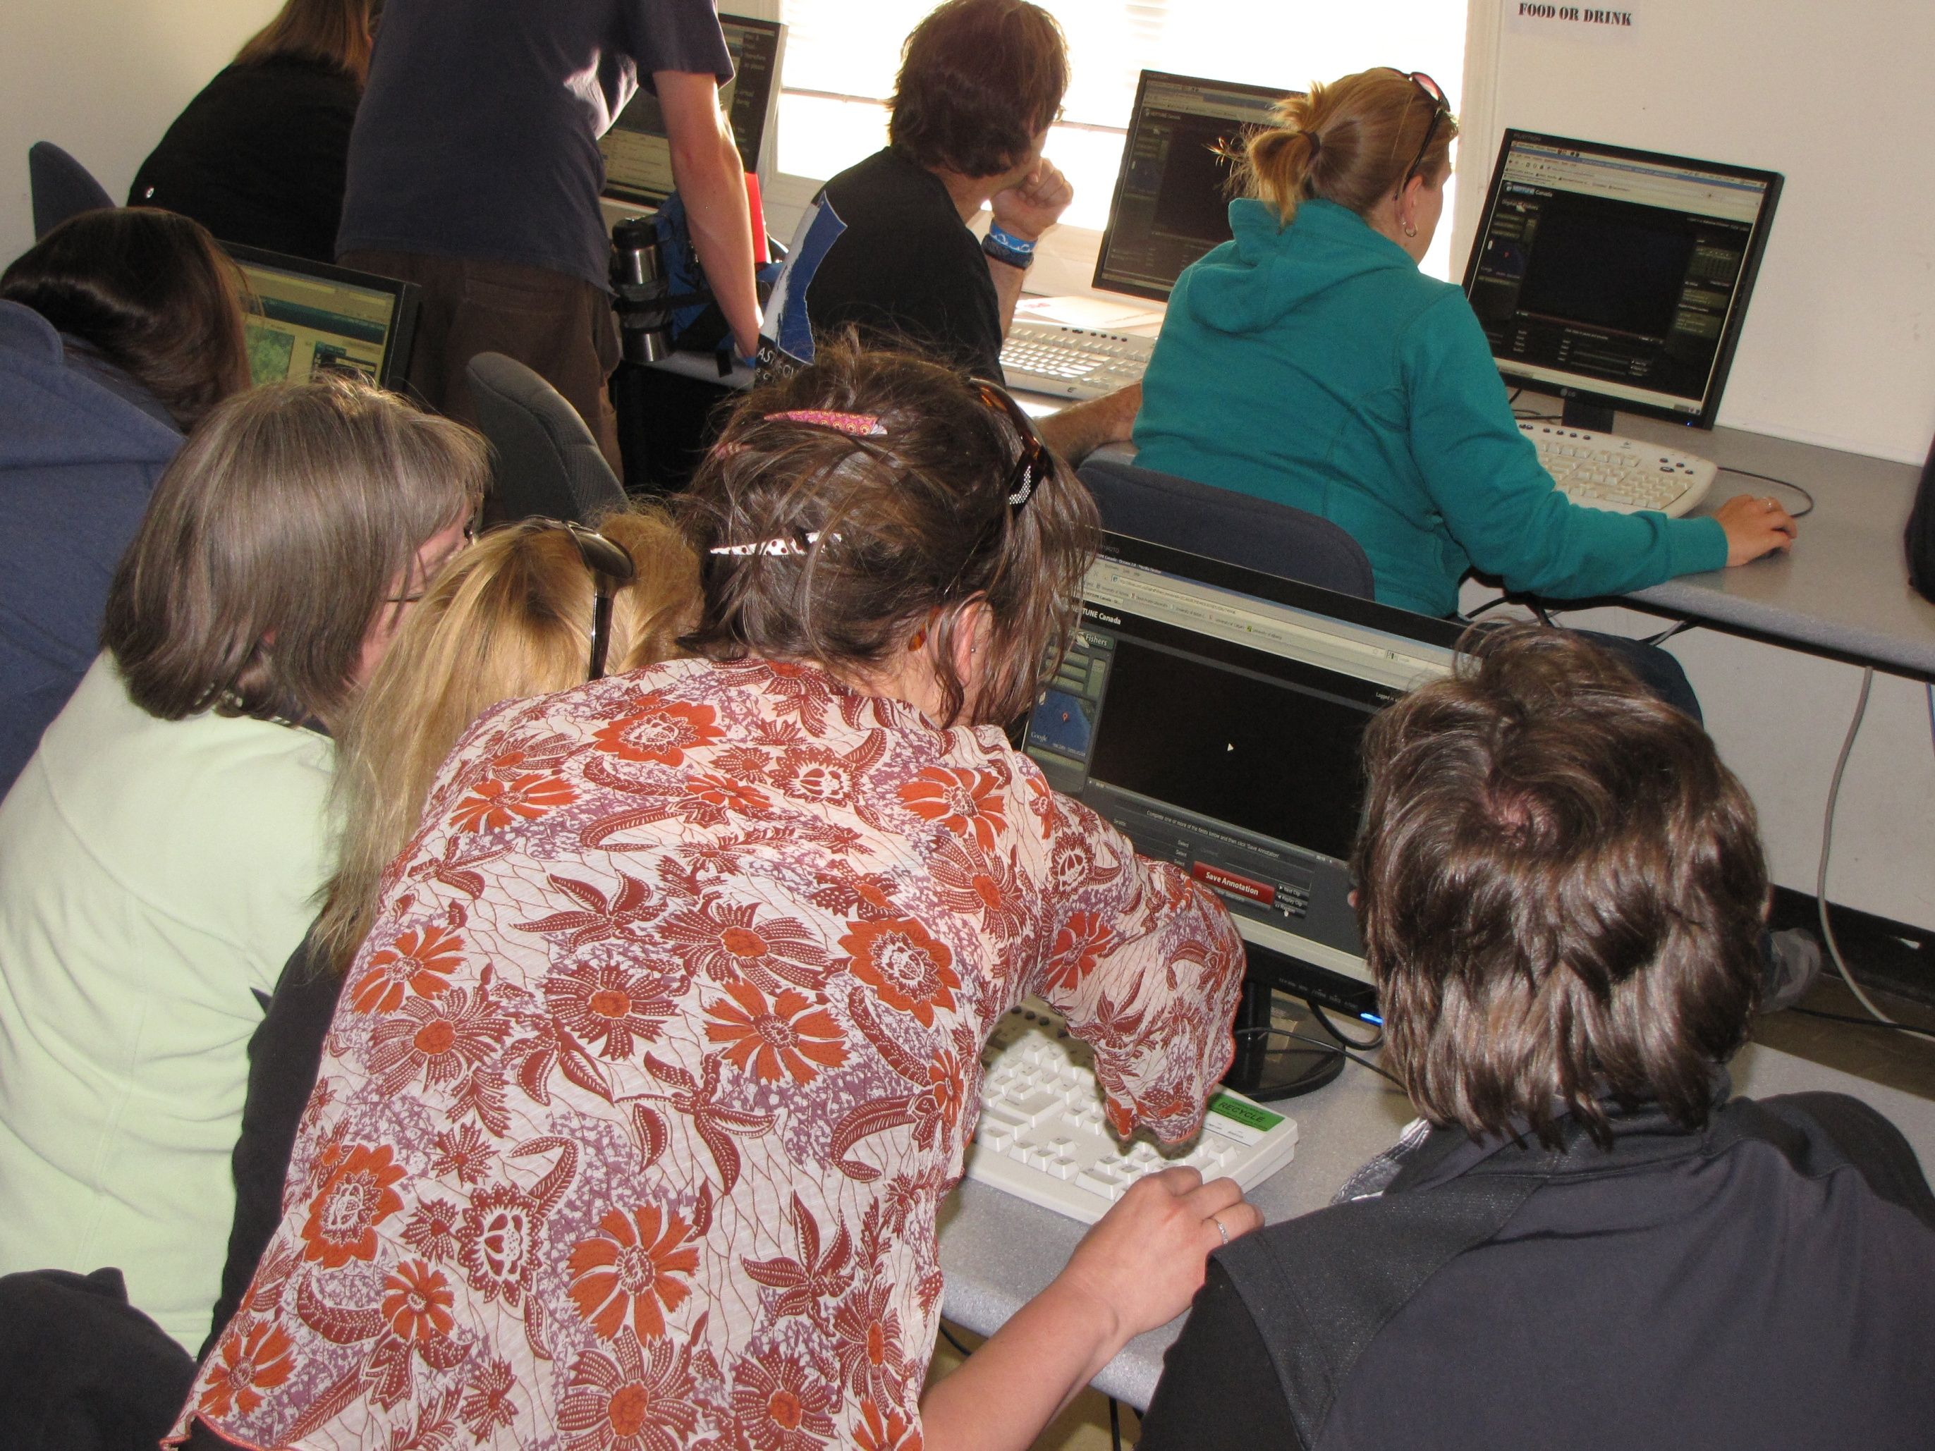
Ocean Networks Canada Observatory:
Encouraging National and International Marine Science Education Initiatives
Outreach Assets:
Real-time data
Video (live and archived)
Hydrophone clips
Video-conferencing
Interactive website
Network of Canadian
educators
Ocean Networks Canada
Observatory:
Consisting of
VENUS and NEPTUNE Canada networks
Enabling discovery through novel research approaches;
Building a new generation of scientists and engineers;
Exciting and engaging educators and the public;
Advancing ocean literacy
International Collaborations:
COSEE
  COSIA course for post secondary students
NAME
  Board of directors
  Workshop at conferences
NANOOS
  VENUS network data on website
Canadian Partnerships:
Vancouver Aquarium
Let’s Talk Science
Canadian Museum of Nature
Maritime Museum of BC
Bamfield Marine Sciences Centre
Brentwood College
Pearson College
Possible Collaborations:
Ocean Science Symposium
World Ocean Day 2012/2013
Network of post-secondary Ocean Students Societies
Professional development
opportunities for students
Teacher Workshops
K-12 learning resources
Our Invitation
We’re eager to explore outreach collaborations of all kinds!
Contact Us:
oceaned@uvic.ca
Rick Searle, Manager , Communications & Engagement
Natasha Ewing, K-12 Education Developer
Ellyn Davidson, Post-Secondary Education Developer
Virginia Keast, Communications & Engagement Officer

